Slide 1
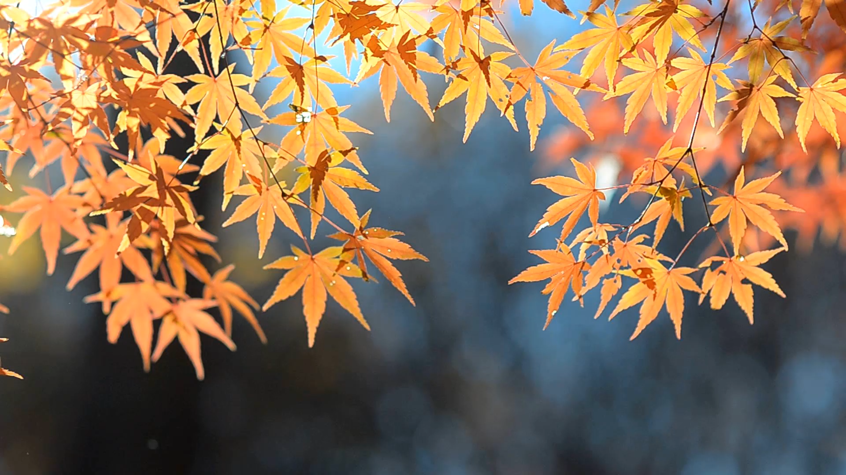
Happy Autumn Equinox!!!
21 Sept 202x

